Slide 1


MSP Ordinance 127
AOA Driver’s Training
MAC Airside Operations
612-726-5111

Slide 2
Ordinance 127
History of MSP Driving Ordinances
Who does it cover
What Training is required
  Letter of Compliance
Notes:
Ordinance 127 in effect as of March 1, 2018 replacing Ordinance 105
Requires all vehicle operators on the AOA to be trained by their companies
Those that drive on the movement area need to go through MAC testing
Training is required once every three years for AOA only drivers, once every year for movement area drivers
Companies send in Letter of Compliance once they have trained their employees

Slide 3
Major changes in Ordinance 127 from Ordinance 105
Requires non-flight crew personnel who taxi an aircraft to have a Tow license
Requires brake riders to have the appropriate tow license
Changes Gross infractions from 6 to 7 points
Prohibits use of cell phones or other electronic devices while on the Movement Area
Notes:
Prohibition on Electronic devices does not apply to radios used to communicate with ATCT or other company personnel

Slide 4
Major changes in Ordinance 127 from Ordinance 105 (continued)
Requires using designated roadway when travelling more than 2 gates (was 4)
Requires 100 sq. inches of reflective material on each side of vehicle (was 50)
Requires logos on each side of vehicle
Requires Transponder to be on when aircraft is being towed or taxied
Notes:
If logo is reflective, an at least 100 square inches, then there is no need for additional reflective material
Unless unique transponder code has been assigned by ATCT, a squawk code of “0000” should be used

Slide 5
Major changes in Ordinance 127 from Ordinance 105 (continued)
Drivers and/or Companies need to report the following information to the Drivers Training Center (DTC):
  When a Driver no longer needs access to the Movement Area. This notification must take place prior to the expiration of the license
Upon Expiration of a license, Drivers and/or Companies need to advise DTC that the driver will not operate on the Movement Area while license is expired
Notes:
Failure to follow the first item listed above is a Major (3 point) violation
Failure to follow the second item listed above is a Gross (7 point) violation

Slide 6
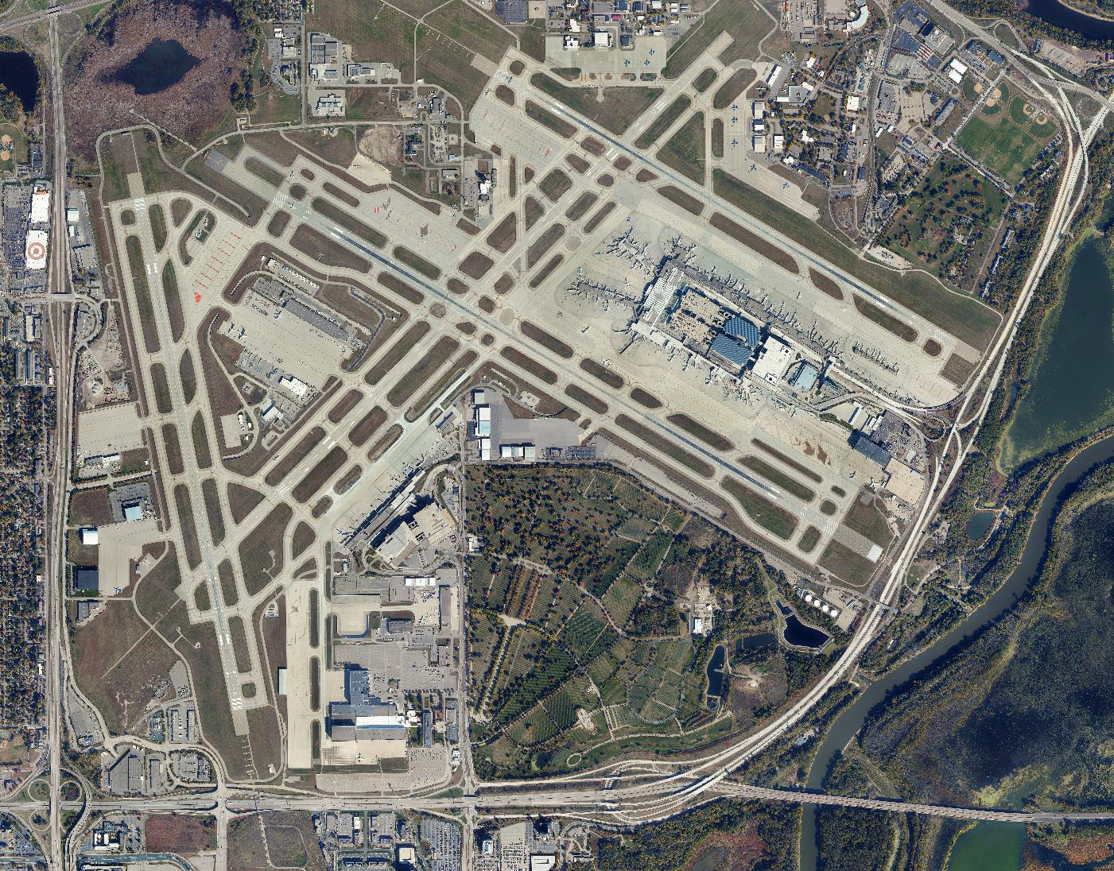
Notes:
In 2019, there were 406,073 Operations at MSP (~1,113 per day)
In 2020, that dropped to 244,911 (~669 per day)
Approximately 12,000 drivers from 500 different Companies

Slide 7
DRIVER AND VEHICLE REQUIREMENTS

Slide 8
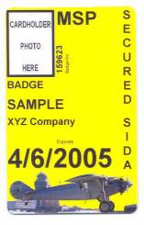
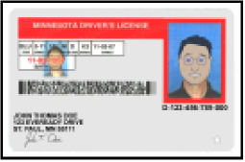
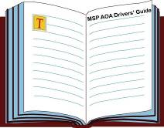
Driver Requirements
Notes:
Driver’s need to have valid state DL (doesn’t have to be MN), valid security badge and training provided by the Company
Training needs to be provided at least once every three years for AOA Driver’s
Anyone that will be driving on the Movement Area (runways, taxiways and safety areas) must receive training once per year and have a Movement Area license issued by MAC.

Slide 9
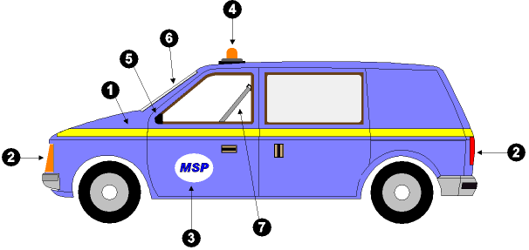
Vehicle Requirements
Reflectorized Logo or Striping of at least 100 sq. inches
Headlights and Taillights (or reflectorized material on front, rear and sides of vehicle)
Company logo on Driver and Passenger side of vehicle
Beacon on the highest point of vehicle
At least one rear view mirror
Windshield not cracked, discolored or obstructed
Seat Belts for all passengers
Notes:
Need Logo on each side of vehicle
Also need 100 sq. inches of reflective material on each side of vehicle. If logo is reflective, and at least 100 sq. inches, no need for additional reflective striping
Need a seat, and seat belt, for each passenger
Beacon needs to be on highest point of vehicle and turned on anytime vehicle is in AOA
Vehicles need $5,000,000 of insurance.
See Ordinance 127 for more details

Slide 10
DRIVING ON THE NON-MOVEMENT AREA

Slide 11
Definitions
Air Operations Area (AOA) – All areas within the perimeter Fence
Movement Area – Runways, Taxiways and Safety Areas
Non-Movement Areas – All other Areas within AOA
Notes:
Page 3-1
Examples of Non- Movement Area – roadways, Aprons

Slide 12
The First Thing to Remember when driving on the Airport
All Aircraft Have the Right of Way!

Slide 13
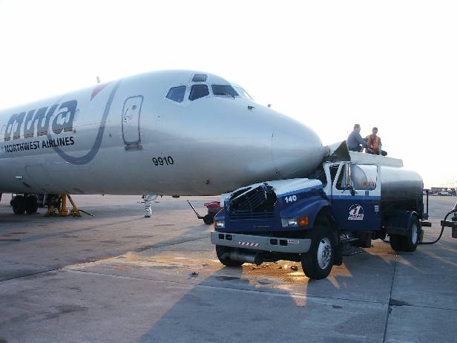
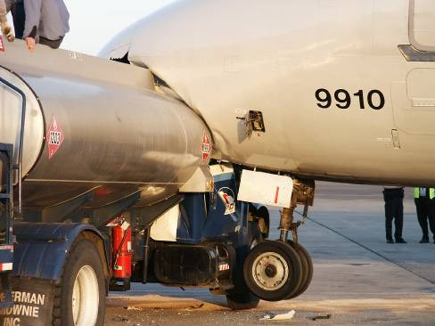
Even Parked Aircraft!
Notes:
This accident involved a fuel truck striking parked aircraft, and is a good reminder that drivers need to maintain their situational awareness at all times

Slide 14
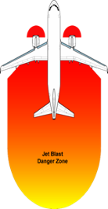
General Safety
Look at your surroundings
Anticipate movements of others
Respond to what is occurring around you
Caution - Jet blast
Notes:
Stay at least 200’ behind an operating jet engine, and also avoid the area just in front of the engine as there is an ingestion hazard in this area.

Slide 15
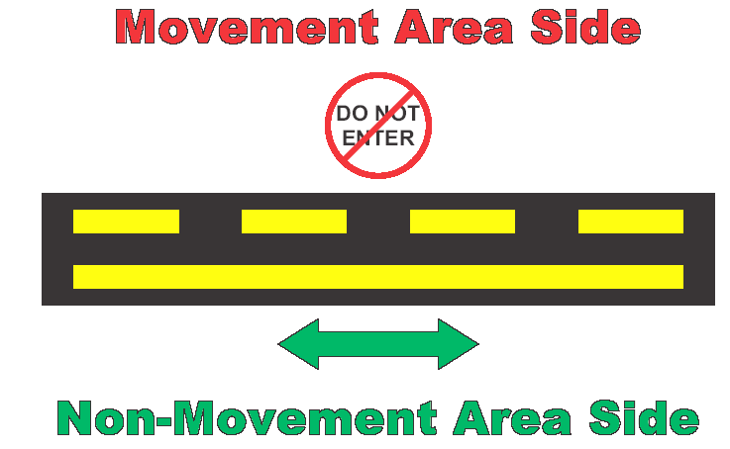
Non-Movement Area Boundary Marking
Crossing of this marking will result in a Movement Area Incursion
Notes:
In order to cross this line, a driver needs to have a valid Movement Area License, or be under escort by someone who does.

Slide 16
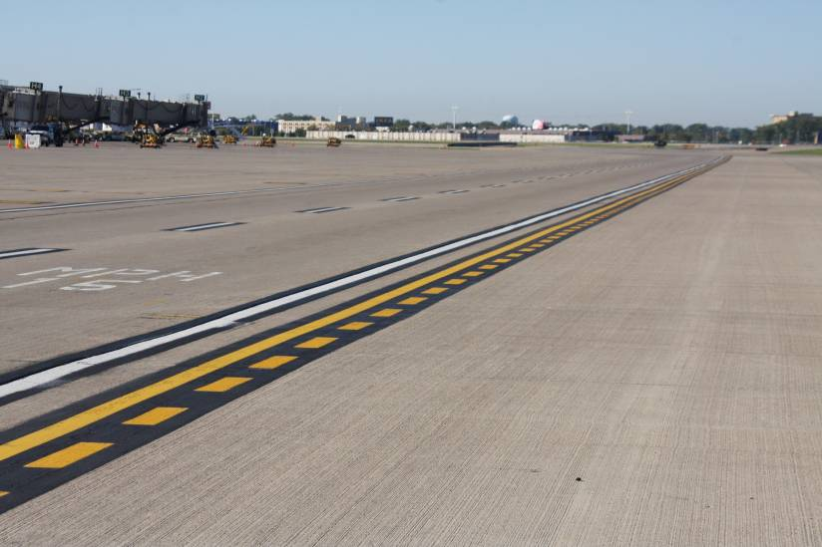
Where is a Non-Movement Area
Boundary Marking Located?
Notes:
Just beyond roadway edge
This picture taken abeam HHH

Slide 17
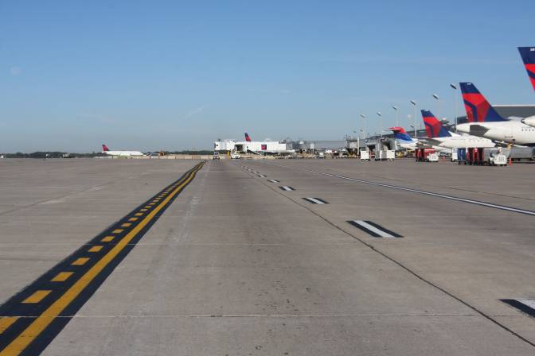
Where is a Non-Movement Area
Boundary Marking Located?
Notes:
Sometimes it serves as edge of roadway
This picture taken on G concourse

Slide 18
Speed Limits on the AOA
Gate areas = 5 mph
Service roads, unless posted = 15 mph
Other areas as posted = 25 to 35 mph

Slide 19
Use of Designated Roadways
Must use when traveling more than 2 gates – was previously 4
Aircraft have right of way at all times, even when crossing roadway
Don’t stop or park on roadway, except to yield to an aircraft
Do not drive between marshaller and aircraft
Notes:
Page 4-10
must use when moving more than two gates (Ordinance 127 switched this back from four to two)

Slide 20
Disabled Vehicles
Do not leave on or near the movement area
Turn on lights/flashers if equipped
Immediately notify your supervisor and MAC Airside Operations at 612-726-5111
Stay with vehicle

Slide 21
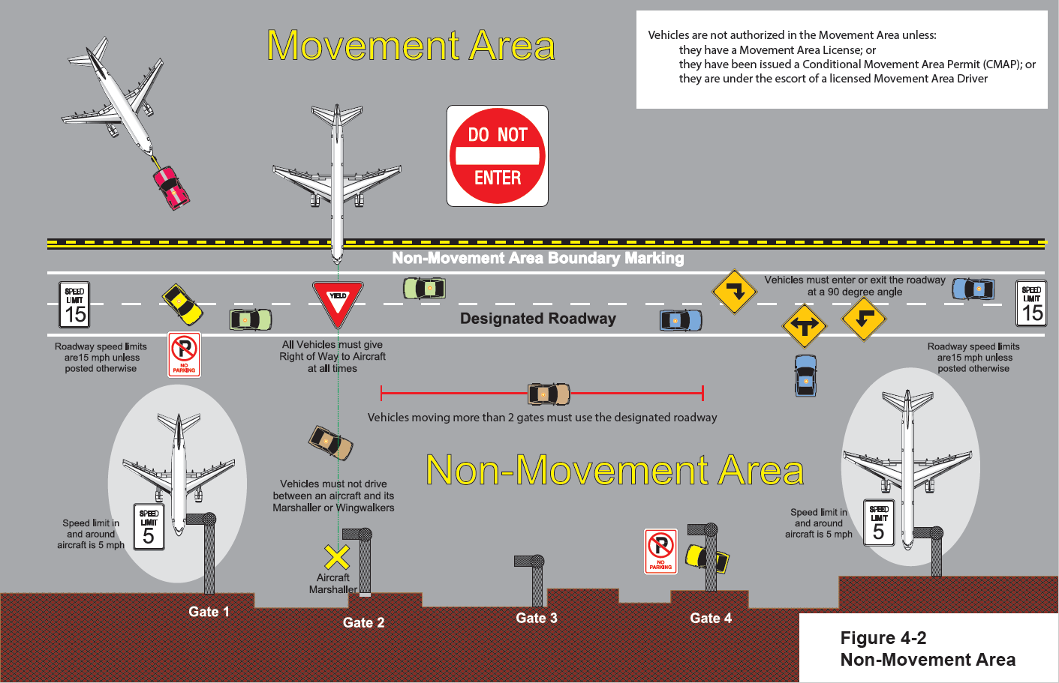

Slide 22
MOVEMENT AREA
Notes:
The information presented

Slide 23
Remember, you are not authorized to drive on the Movement Area, unless you are under escort.

Slide 24
The following slides are presented to show you the type of signs and markings that can be found on the Movement Area to help you know if you have inadvertently entered the Movement Area
Notes:
If you have any questions about where you are, or if you get lost, contact Airside Operations at 612-726-5111.

Slide 25





Markings
Taxiway Centerline
Enhanced Taxiway
Centerline Marking
Continuous
Taxiway Edge
ILS Critical Area
Dashed
Notes:
If you see yellow markings (the paint on the ground) on the surface you are driving on, you are most likely on a taxiway.
The markings on a taxiway are yellow, but they are outlined in black to help them stand out.

Slide 26
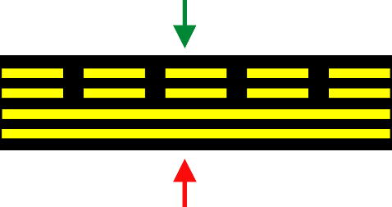

Markings (cont’d)
Runway
Holding Position
Non-Movement
Area Boundary
Notes:
Crossing either of these markings without permission may result in an incursion.
The top marking is found on all taxiways that lead to a runway. Crossing the two solid lines will put you in the Runway Safety Area and result in a Runway Incursion.
If a driver encounters this marking, they should stop and ask for help. DO NOT cross the solid line
Crossing the solid line of the non-movement area boundary marking, unless you are under escort, will result in a Movement Area Incursion.

Slide 27


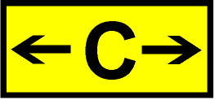

Signs
Taxiway Location
Hold Position
Taxiway Directional
ILS Critical Area Hold Position
Notes:
If you see a red and white sign, STOP. These are called Mandatory Instruction signs and are also known as Holding Position signs.
If you see yellow and black signs on the pavement you are driving on, then you are most likely on a taxiway.

Slide 28
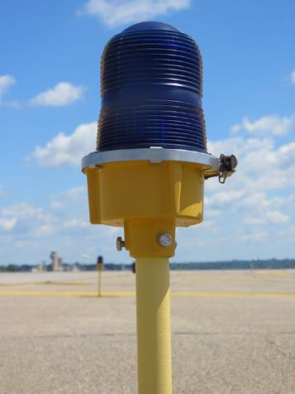
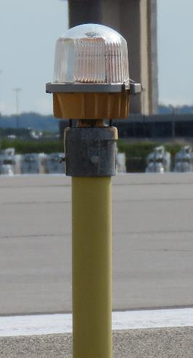

Lighting
Taxiway
Runway
Obstruction
Notes:
If you see blue lights along the edge of the surface you are driving on, you are most likely on a taxiway.
If you see white lights along the edge of the surface you are driving on, you are on a runway. Stop and ask for help.

Slide 29
Incursions
Runway Incursion
Entering any open runway, or associated safety area, without positive clearance from the ATCT
Notes:
Runway incursion prevention is the main reason for the entire driver’s training program
If you cross a Runway Holding Position sign or marking without permission, you will have committed a runway incursion.
If this happens, and you are aware of it, stop and contact Airside Ops immediately, 612-726-5111.

Slide 30
Incursions (cont’d)
Movement Area Incursion
A person or vehicle crossing the non-movement line without ATCT permission, MSP Driver’s License, CMAP, or Escort
Notes:
Similar to a runway incursion, if you find that you are on a taxiway, or any other part of the movement area, unintentionally, stop and contact Airside immediately.

Slide 31
Runway Zones of Defense
Notes:
The point of the Zones of Defense concept is that there are several things that can assist a driver’s situational awareness to let them know that they have driven into an area where they shouldn’t have.
Pay attention to things like the color of the markings, the types of signs/markings you’re seeing.
The driver’s guide provides specific descriptions of each of the numbered items:
Ramp
Ramp Roadway
Non-Movement Line
Taxiway Safety Area
Dashed Taxiway Edge Line
Taxiway Centerline
Continuous Taxiway Edge Line
ILS Holding Position Marking
ILS Holding Position Sign
Enhanced Taxiway Centerline Marking
Surface Painted Holding Position Sign
Runway Holding Position Marking
Runway Holding Position Sign
Runway Side Stripe

Slide 32
SPECIAL DRIVING CONDITIONS

Slide 33
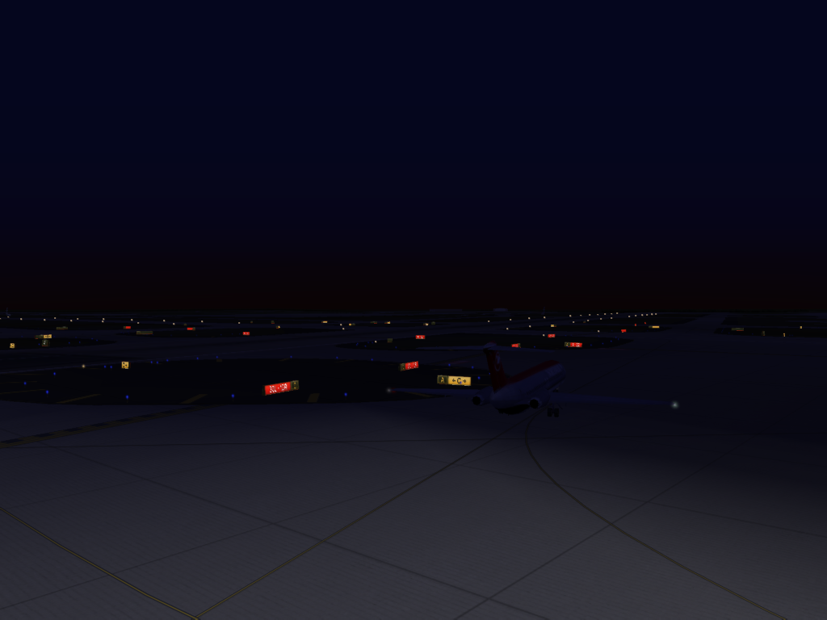
Night Driving
Notes:
Situational awareness is key to driving at night.
Take extra precautions until you are familiar with the way the airfield looks at night.
Pay extra attention to the signs and lights you see, and remember that you may never cross the red and white holding position signs, unless you are under escort from a licensed Movement Area driver.

Slide 34
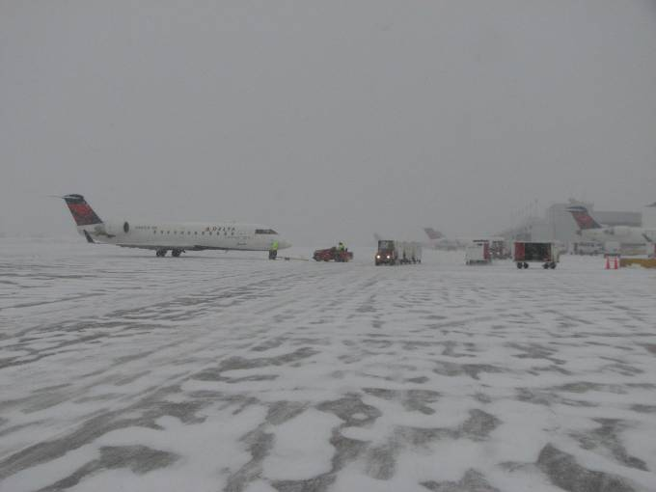
Inclement Weather Driving
Where’s the road?
Notes:
Roadway markings can be obscured easily in a snow event, especially when heavy traffic compacts snow and covers the markings.
If you can not see the markings, or are not sure where you should be driving, stop and ask for help.

Slide 35
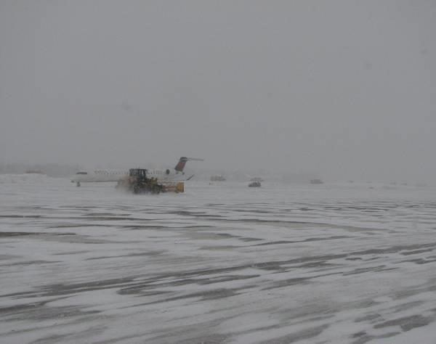
If you get lost or disoriented due to limited visibility
Stop and ask for help (from Company, ATCT, or Airside Ops)

Slide 36
SMGCS
Surface Movement Guidance Control System
SMGCS plan at MSP goes into effect when visibility is below 1200’
Vehicle movements prohibited below 300’ visibility
Notes:
When visibility drops below 300’, no vehicle operations are authorized.
If you are unsure of the visibility contact Airside Operations at 612-726-5111.

Slide 37
Accidents
Stop - render assistance to injured
Contact Airport Emergency Communications Center at 911 or 612-726-5577 for Police, Fire and Medical assistance
Do not move equipment
Do not leave scene until Police authorize
All accidents must be reported
Notes:
Police may not respond to every accident, but they still need to be reported.
If police don’t respond, don’t leave the scene until they authorize you to via phone.

Slide 38
FOD (Foreign Object Debris)
FOD is everyone’s responsibility
Don’t create FOD (by littering or allowing items to fall off your vehicle)
If you see FOD, pick it up. If it’s past the non-movement line, call Airside Operations (612-726-5111) to retrieve it

Slide 39
ENFORCEMENT AND APPEALS

Slide 40
Enforcement Actions
Violations of Ordinance 127 may result in:
Warning Citation
Administrative Citation
Immediate Suspension
Impoundment of Vehicle
Notes:
The Airport Police Department enforces Ordinance 127 and they can issue warnings or an administrative citation (paper ticket with points) for a violation.
Certain violations will result in Immediate Suspension of driving privileges or the impoundment of a vehicle.

Slide 41
SUSPENSIONS / REVOCATIONS
Minor Infraction - 1 point
Major Infraction - 3 points
Gross Infraction - 7 points
Severe Infraction - 11 points
0 - 3 points No Action
4 - 6 points Warning Letter Sent
7 - 10 points 7 Day Suspension
11 - 14 points 30 Day Suspension
15+ points 2 Year Revocation
Suspension Level
Notes:
Points stay on your record for 24 months
When suspended, a driver can not drive anywhere on airport, but the individual does not lose their security badge privileges, so they may continue to work as long as they don’t drive.
If you received a Gross infraction or above, you will receive a suspension, even if you have not received points in the past.
The list of violation types (broken down by Minor, Major, Gross and Severe) is located at the end of Ordinance 127.

Slide 42
APPEAL PROCESS
What enforcement actions may be appealed
Must be submitted within 14 days
Airport Director Review if the points will not result in suspension or revocation.
If point level will lead to suspension or revocation, a more formal process is utilized with a Hearing Officer
Hearing Officer shall conduct hearing and issue recommended findings.
May appeal Hearing Officer’s decision for Executive Director review
Suspension Level
Notes:
Page 11-4
Appeals must be submitted within 14 days
How to submit – fax to DTC or put in drop boxes (one outside DTC, one outside POC in Baggage Claim area of Terminal 1). Can also be hand delivered to Airside

Slide 43
QUESTIONS ???

